Slide 1
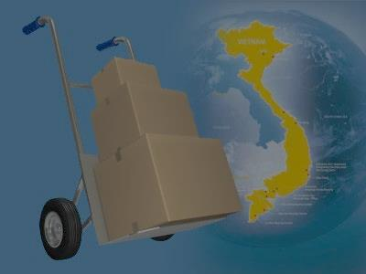
A web-based application that manages the activities of delivery service system by coach
i-DELIVER
SPRING 2014 - Group 18

Slide 2
Team members
Supervisor: Nguyễn Trọng Tài
Nguyễn Thanh Tùng
Lê Phúc Lữ
Nguyễn Tấn Đức
Team leader: Đào Bảo Long

Slide 3
Outline
Current scenario
Propose solution
Demonstration
Advantages & disadvantages of solution
Future plan
Technology & development environment
Algorithm description

Slide 4
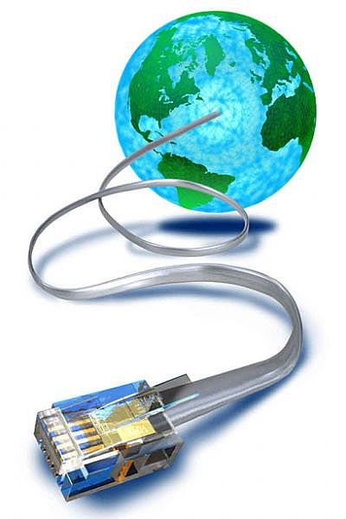

Current scenario
Advantages Disadvantages
No need to setup
Less training
time
Paper documents
No statistics report
Internet connection unnecessary
Ineffective manual work

Slide 5




Actors of system
Customer: person requests for package delivery from their location to another location.
Guest: same as customer but don’t log in
to system so be restricted in some function.
Staff: persons in charge of manage delivery request and manage journey.
System admin: person take
responsibilities of manage staff
and fee.

Slide 6


Propose scenario
[Optional] Payment online
Post request
Notify payment
information
Provide delivery
service, tracking request
Manage services,
users
Manage journey
information
Provide mechanism to manage

Slide 7

Some definitions
4h
178 km
8h
308 km
3h
169 km
Đà Lạt
Cần Thơ
Cà Mau
Sài Gòn
Volume
(L x W x H)
7:00 AM
26 May 2014
7:00 AM
SCHEDULES
STATIONS
STAGES
ROUTES
COACHES
TRIPS

Slide 8
Problems
Trip | Cà Mau | Cần Thơ | Sài Gòn | Đà Lạt | Đà Nẵng | Volume
1 |  |  |  |  |  | 30
2 |  |  |  |  |  | 350
3 |  |  |  |  |  | 400
4 |  |  |  |  |  | 240
Requests (from A to B)
Cà Mau – Cần Thơ: 30 dm³.
Cần Thơ – Đà Lạt: 40 dm³.
Đà Lạt – Đà Nẵng: 50 dm³.
Assign these requests that satisfying constraints about: volume, time.

Slide 9
Detail solution
Find ways:
Build graph G=(V, E) and use breath first
search algorithm to find some ways.
For each way, check the direction is not backward base on the longitude and latitude of stations.

Slide 10
Three main steps
Step 1: request can be delivered on one trip start at A and end at B.
Step 2: request can be delivered by multiple trips must be start and end at specific station of the found way.
Step 3: request can be delivered by multiple trip not necessary start and end at station and request may be transfer at middle of way.

Slide 11
Find routes and trips
Using heuristic idea, try to find:
One route for whole way.
One route for each stages of way.
Two/three/four routes for whole way.
With each list routes, find trips for each route and if satisfy all constraints, store as a solution.
C
E
A
B
D

Slide 12
Choose the best solution
For each found solution, sort base on some criterions:
The arrival time of last trip.
The number of used trips.
Then choose the first solution of list with best fit all constraints.

Slide 13
Positive of algorithm
Use greedy thinking for almost steps of algorithm so fast to find out the solution and it will meet the local optimal of the given optimization problem.
Some list data use for the first request is used for all next request.
Estimate complexity of algorithm:
O((k|V||E|² + |E|⁴) x |T| x |R| x |S| x |I|).
with |T|, |R|, |S|, |I| are number of trips, routes, stages and requests.

Slide 14
Negative of algorithm
The steps of algorithm are separately performed so in some case, the solution exist but can not be found (tricky or special case).
Some step of algorithm can be implemented better to reduce the complexity but still not have done.

Slide 15







Technology & development environment

Slide 16
DEMONSTRATION

Slide 17

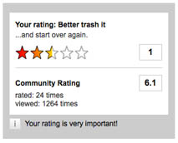

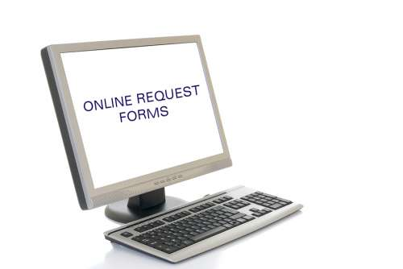

Feature of new system
Request for packages delivery easily
Simple way to tracking packages
Online payment
Rating and comment
Easy to manage packages
Statistics on revenue

Slide 18


Constraints of new system
Each station must have staff with basic computer skills to mange request & journey
Each station must have computer connects to Internet

Slide 19



Future plan
Develop mobile applications for manage packages pick-up/delivery process at customer’s house
Develop and optimize algorithms for coach scheduling and reduce cost of delivery process

Slide 20
Thanks for your listening! Q&A

